Slide 1
Module 14 – Studio Maven Support

Slide 2
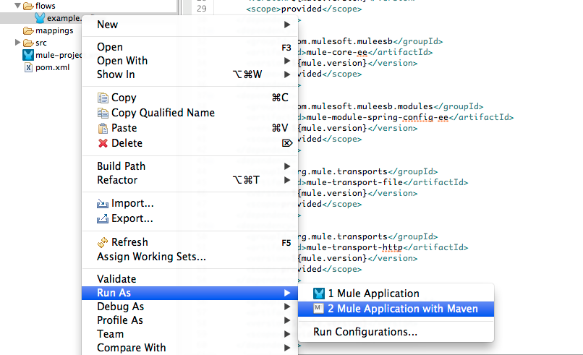
Mule Studio and Maven
Mule Studio can now build and run Maven projects (New in 3.4)
Convert Maven project to Mule Studio project
Convert Mule Studio project to use Maven
Notes:
Mule Studio can now build and run Maven projects (New in 3.4): As of 3.4, one may build and run Maven projects in Studio, whereas previously one had to run maven commands manually on the project and import into Studio
Convert Maven project to Mule Studio project: It is possible to convert an existing Maven project into a Studio project by running the aven command ‘mvn studio:studio’. This will generate all the required artifacts for importing into Studio.
Convert Mule Studio project to use Maven: It is possible to use the Studio wizard to add maven support to an existing studio project (adds a pom.xml file).

Slide 3
Dependency Management
Studio populates Maven repo with Mule dependencies
populate_m2_repo script is run
One may turn on/off Maven support for a project
Maven support does not change behavior
When updating project dependencies, the classpath is updated
By dragging a component into the canvas, Mule updates the pom.xml file automatically with all required dependencies
Notes:
Studio populates Maven repo with Mule dependencies: when a Studio Maven project is run for the first time, Studio will run a script that populates the maven repository with Mule dependencies.
One may turn on/off Maven support for a project: it is intended that a Studio project with Maven support may work in the same way as one without maven support.
When updating project dependencies, the classpath is updated: if one adds a dependency to a project, Maven will install that dependency and Studio will update the class patch accordingly.

Slide 4
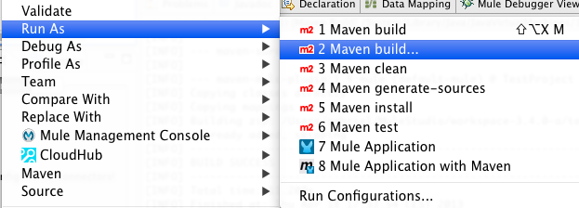
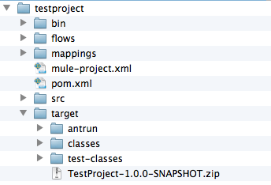
Deploying Mule-Maven Projects
mvn package
Mule packages the project in a .zip file inside the target folder
deploy the .zip file from the target folder to your Mule ESB to run the app

Slide 5
Troubleshooting Maven issues in Studio
What to do when Studio cannot find dependencies?
If initial script is interrupted, then Mule dependencies are not installed properly
Update dependencies
R. click on project -> update studio dependencies
Use command line to update dependencies
Notes:
What to do when Studio cannot find dependencies?
If initial script is interrupted, then Mule dependencies are not installed properly: initial script should install all required Mule dependencies, however if this is interrupted, Studio will not run properly.
Use command line to update dependencies: when Studio f
Manually remove problematic dependency from repo; this forces maven to download again

Slide 6
Fixing Dependency Issues Manually
1) Locate your project in workspace
Run ‘mvn studio:studio’
2) Manually install missing dependencies, example:
mvn install:install-file -DgroupId=com.mulesoft.muleesb.modules -DartifactId=mule-module-plugin-ee -Dpackaging=jar -Dversion=3.4.0 -Dfile=mule-module-plugin-ee-3.4.0.jar -DgeneratePom=true
3) Run populate_m2_repo script from standalone
MULE_HOME/bin/populate_m2_repo ~/.m2/repository/
4) Manually remove problematic dependency from repo and try to re-install

Slide 7
Known Issues
Maven-Mule-Plugin issue
Previously, when adding a plugin to studio, related dependencies were grouped (expanding ‘plugins’ folder, eg. Salesforce)
Now, with Maven support, Studio does not know which dependencies belong to the same plugin for example
Notes:
Maven-Mule-Plugin issue:

Slide 8
Useful Links
Studio and Maven
http://www.mulesoft.org/documentation/display/current/Studio+and+Maven
m2eclipse
http://eclipse.org/m2e/download/

Slide 9
Module 14 – Studio Maven Lab

Slide 10
Studio Maven – Lab Primer
The aim of this lab is to add Maven support to the existing Lab project
Add pom.xml and include required dependencies:
activemq-all-5.5.1
derby-10.6.1.0
commons-collections-3.2.1
commonse-lang-2.4

